Slide 1
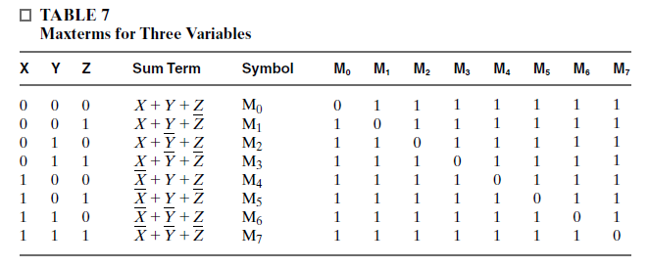
NOTES

Slide 2
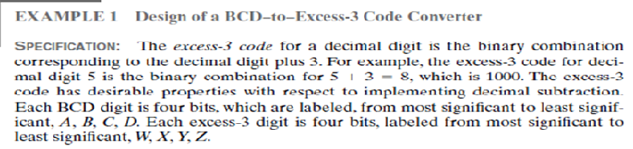
Example 1

Slide 3
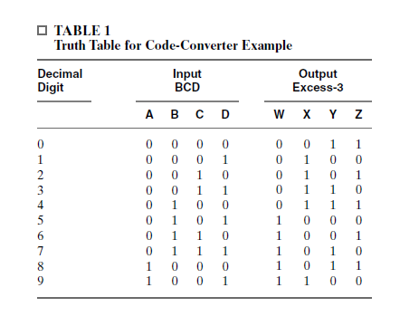
Make a Truth Table

Slide 4
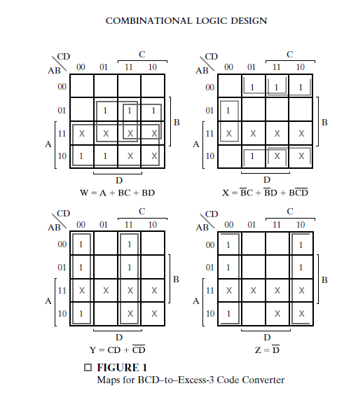
K-MAP

Slide 5
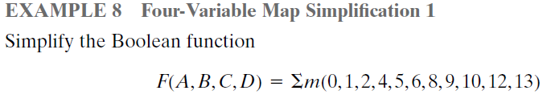
Example 2

Slide 6
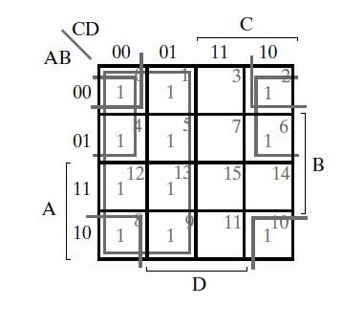

Example 2

Slide 7
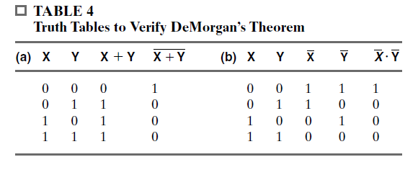
DeMorgan’ s Theorem

Slide 8
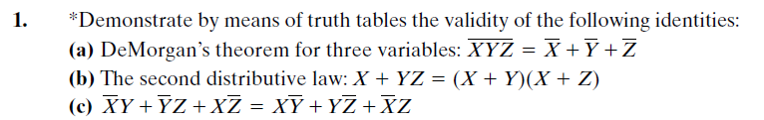
Example of DeMorgan’ s Theorem

Slide 9
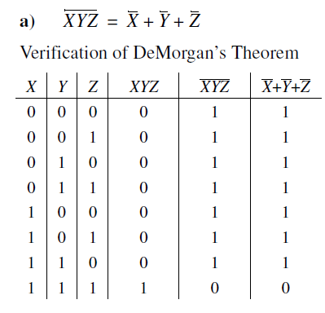
Example of DeMorgan’ s Theorem

Slide 10
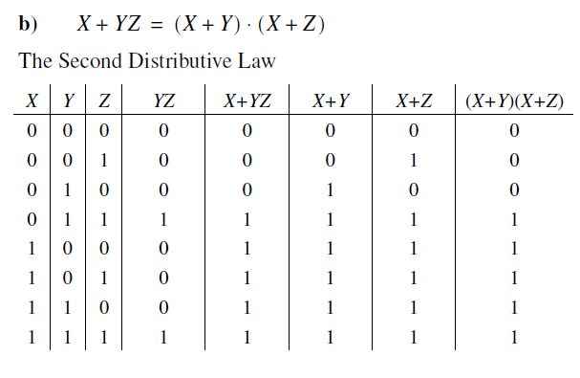
Example of DeMorgan’ s Theorem

Slide 11
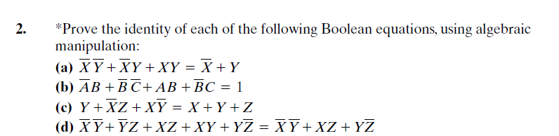
Boolean EQUATION

Slide 12
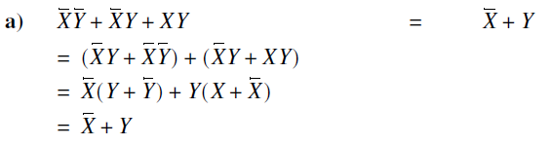
Solution a

Slide 13
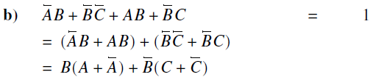

Solution B

Slide 14
HOMEWORK
Solve the equation c and d.
Upload the digital copy to our page till due date.

